Slide 1
AI-Powered Resume Job Match Scorer
Using Python, Streamlit & Machine Learning
Presented By:
Your Name – Jaishree Kushwaha
Branch – Computer Science and Engineering
College – R.R Group of Institutions
Guide Name -

Slide 2
Agenda
Introduction
Problem Statement
Objectives
Technologies Used
System Architecture
Project Workflow
Machine Learning Algorithm
Features
Working Demo
Results
Advantages
Limitations
Future Scope
Conclusion

Slide 3
Introduction
Resume screening is an important part of recruitment.
Recruiters receive hundreds of resumes for every job opening.
Manual resume screening is:
Time consuming
Error-prone
Difficult for large companies
4. Our project automates resume matching using Artificial Intelligence techniques.

Slide 4
Problem Statement
Problems :
Manual resume screening takes significant time.
Recruiters may overlook qualified candidates.
Candidates do not know how well their resume matches a job.
ATS systems often reject resumes because of missing keywords.

Slide 5
Objectives
Compare resume with job description.
Calculate Resume Match Score.
Extract important skills.
Detect missing skills.
Suggest improvements.
Generate downloadable analysis report.

Slide 6
Technologies Used
Technology | Purpose
Python | Programming
Streamlit | Web Application
Scikit-Learn | TF-IDF & Cosine Similarity
PyPDF2 | PDF Text Extraction
Matplotlib | Charts
Regular Expressions | Text Cleaning

Slide 7
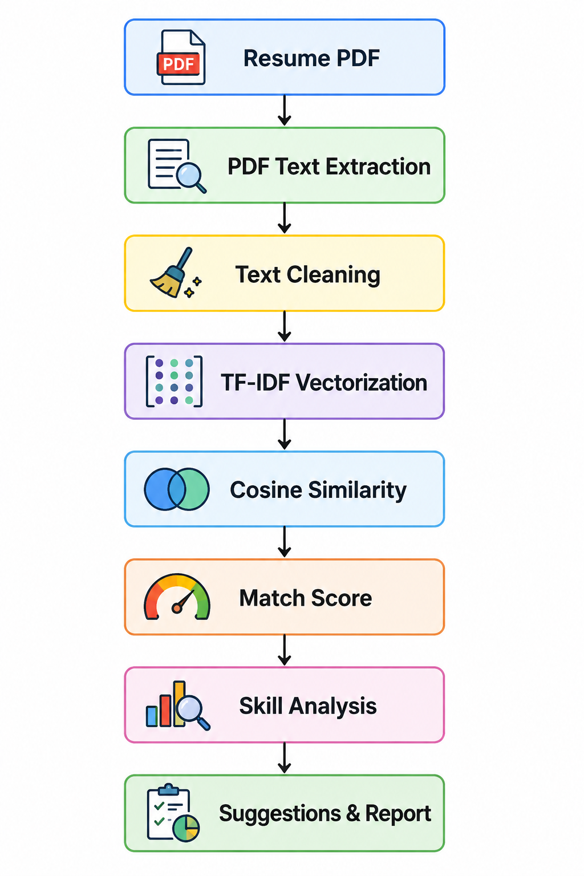
System Architecture

Slide 8
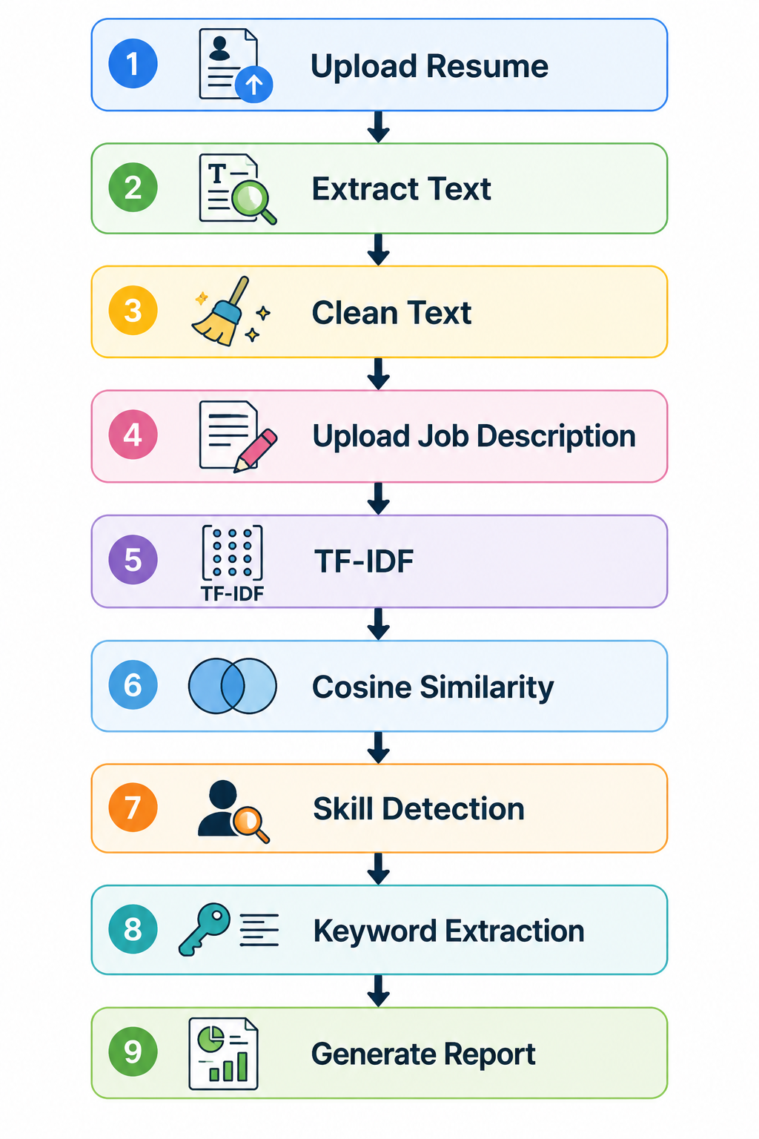
Project Workflow

Slide 9
Features
Resume Upload
PDF Reader
Job Description Input
Resume Score
Matched Skills
Missing Skills
Keyword Extraction
Resume Suggestions
Download Report

Slide 10
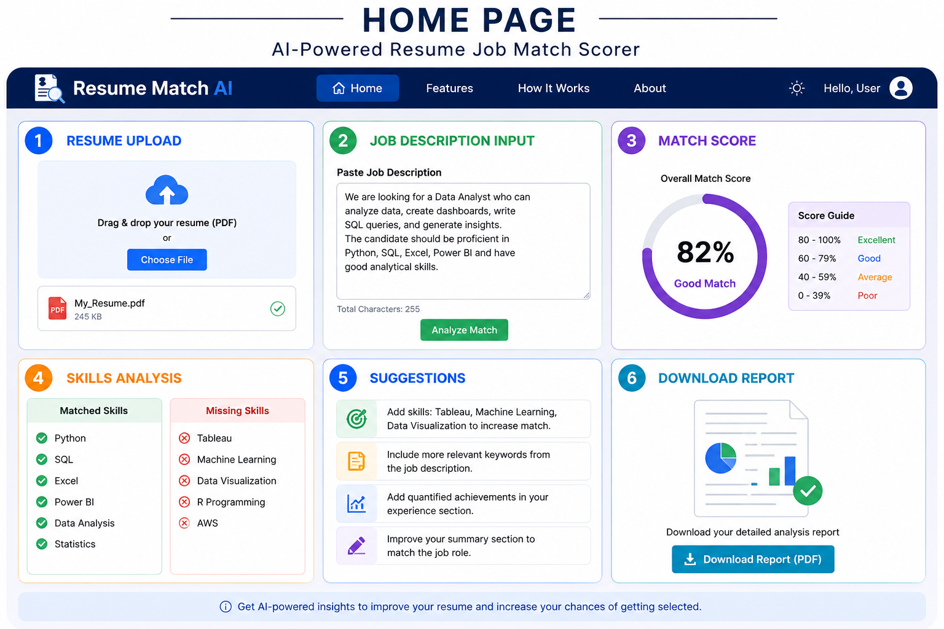
Project Interface

Slide 11
Advantages
Fast Resume Screening
Easy to Use
Saves Time
ATS Friendly
Helps Job Seekers
Better Resume Optimization
Accurate Text Matching
Professional Reports

Slide 12
Limitations
Works best with text-based PDFs.
Scanned PDFs require OCR.
Uses text similarity rather than semantic understanding.
Skill detection depends on the predefined skill library.
Does not evaluate interview performance or practical ability.

Slide 13
Future Scopes
OCR for scanned resumes
LLM-based resume analysis
ATS score prediction
Resume rewriting
LinkedIn integration
Multiple resume comparison
Cloud database
AI chatbot assistant
Job recommendations

Slide 14
Conclusion
The AI-Powered Resume Job Match Scorer automates resume screening by comparing resumes with job descriptions using TF-IDF and Cosine Similarity. It helps candidates improve their resumes through skill analysis, keyword extraction, and personalized suggestions while reducing manual effort in the recruitment process.

Slide 15
Thank You

